Slide 1
Name: Jiao Chenghao
Date: 26/08/2020
The start checking of weaving machines based on reinforcement learning

Slide 2
Catalogue
Introduction & Literature Review
Part 1
Theoretical basis
Part 2
The control of agents in reinforcement learning
The module & codes
Environment of algorithm
RL logic of algorithm
Run the codes
Part 3
Part 4
Conclusion of the experiment
Part 5
Expectation

Slide 3
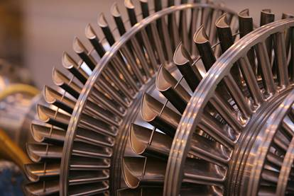
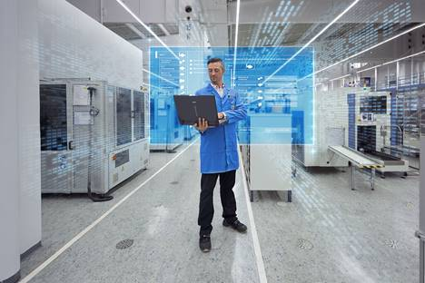
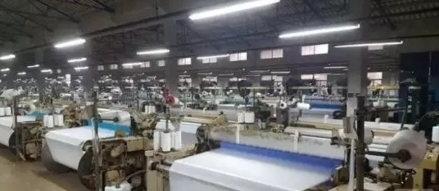
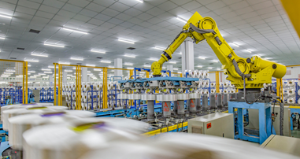
Part1 Introduction & Literature Review
Most of literature focuses on the use of reinforcement learning to optimize the scheduling for the factories , thus increasing productivity
The first industrial Revolution
Now the fourth industrial Revolution is under way
At present, the digitization level of textile industry lags behind
Innovation in the textile industry led the first industrial revolution
Artificial intelligence plays an important role in manufacturing
Many textile mills have old models of machinery and equipment that are difficult to convert digitally
Reinforcement learning can be used for startup self-testing of weaving machines
The first steam loom， 1784
shuttle flying， 1733
From 2012 to now
1800
1900
2000
IoT
steam engine
AI
Big Data
Notes:
来自西门子ADB training
信息物理系统(cyber physical systems,简称CPS)作为计算进程和物理进程的统一体，是集成计算、通信与控制于一体的下一代智能系统。信息物理系统通过人机交互接口实现和物理进程的交互，使用网络化空间以远程的、可靠的、实时的、安全的、协作的方式操控一个物理实体。
信息物理系统包含了将来无处不在的环境感知、嵌入式计算、网络通信和网络控制等系统工程，使物理系统具有计算、通信、精确控制、远程协作和自治功能。它注重计算资源与物理资源的紧密结合与协调，主要用于一些智能系统上如设备互联，物联传感，智能家居，机器人，智能导航等。
CPS是在环境感知的基础上，深度融合计算、通信和控制能力的可控可信可扩展的网络化物理设备系统，它通过计算进程和物理进程相互影响的反馈循环实现深度融合和实时交互来增加或扩展新的功能，以安全、可靠、高效和实时的方式检测或者控制一个物理实体。
CPS赋予了人类和自然界一种新关系。CPS将计算，网络和物理进程结合在一起。物理进程受到网络的控制和监督；计算机收到它所控制物理进程的反馈信息。在CPS系统中，物理进程和其它进程紧密联系、相互关联，充分利用不同系统间结构的特点。CPS意味着监测各项物理进程并且执行相应的命令来改变它。换句话说，物理进程被计算系统所监视着。该系统和很多小设备向关联，他们拥有无线通信，感知存储和计算功能。在现实物理世界中，各项物理进程是自然发生的，而CPS是一种人为物理系统或者说是一种将人类和物理世界相结合的更为复杂的系统。
Have a look at the time delays between the appearance of a technology and us speaking of an industrial revolution: The first tests with electrical circuits happened more than 100 years before Industry 2.0; for Industry 3.0 we're at around 70 years; for Industry 4.0 at around 50 years. The innovation cycles are becoming shorter, and that's one of the main attributes of digitalization: SPEED! And with speed comes: UNCERTAINTY!
Back to the strategic perspective: How does this Industry 4.0 story fit to our EAD Story (electrification, automation, digitalization)? Well – pretty simple! Electrification and automation are the basis for melting the virtual and real worlds together, and that’s digitalization. Our strategy is made to support this evolution.

Slide 4
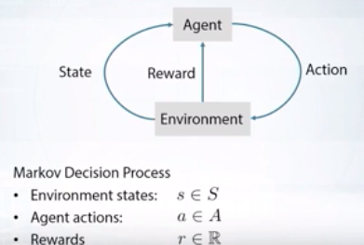
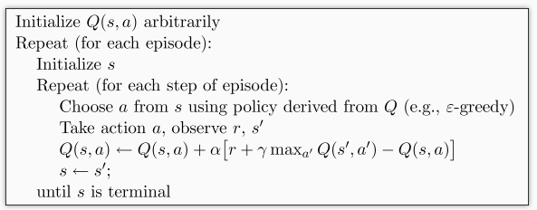
Part2
Theoretical basis
1
Experiment
Q Learning
Markov Decision Processes
Data base of RL learning

Slide 5
Part3&4
Model & Experiment
企业如何建立数字化时代的可持续竞争力：
The experiment
The rate of success had risen from 30% to about 85%
Run the codes
run for 100 episode
Env & RL brain
Environment
RL brain
= the agent (piece)
specified_ greedy=0.9
= the hell ( reward=-1)
learning Rate (α) = 0.01
= the end point ( reward= 2)
processing modules: numpy & pandas
客
The model
Building a checkerboard background
The vertical columns of a checkerboard = Every item of textile machine boot’s starting self - check
= dynamic parameter of every item
= the right parameter
= wrong parameter
Original codes are from: https://github.com/MorvanZhou

Slide 6

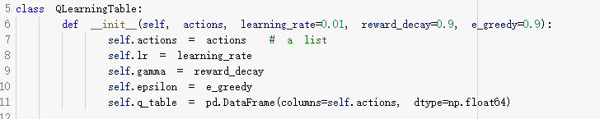
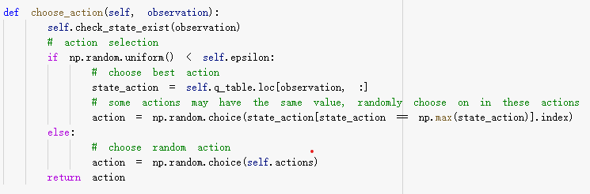
Default value
01
Name: Jiao Chenghao
Date: 26/08/2020
Determining behavior

Slide 7
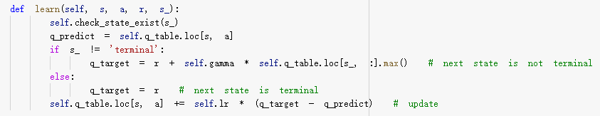
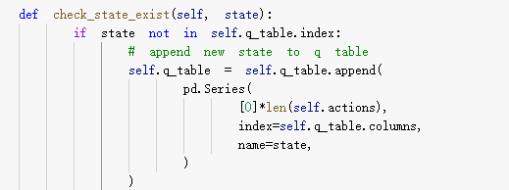
Learning
02
Name: Jiao Chenghao
Date: 26/08/2020
Check the state

Slide 8
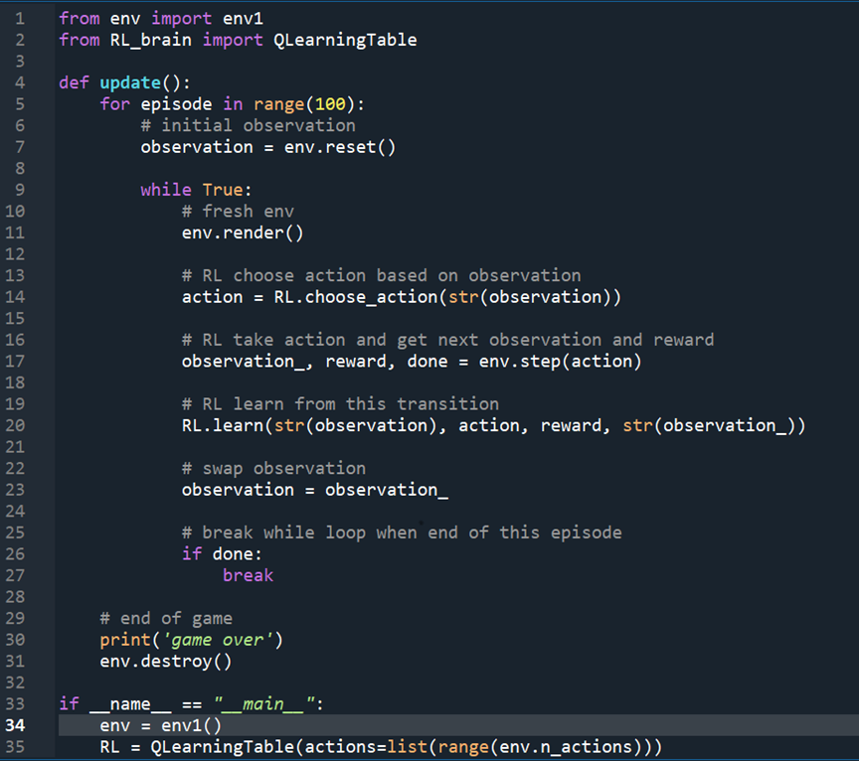
The running part
03
Name: Jiao Chenghao
Date: 26/08/2020
This part was running in spyder on Anaconda

Slide 9
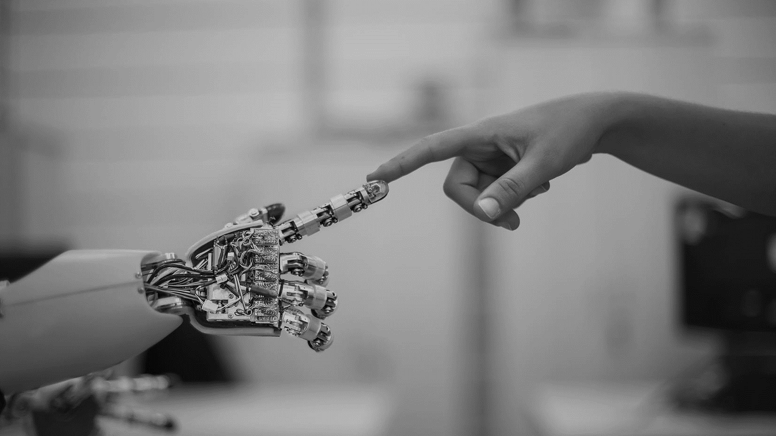
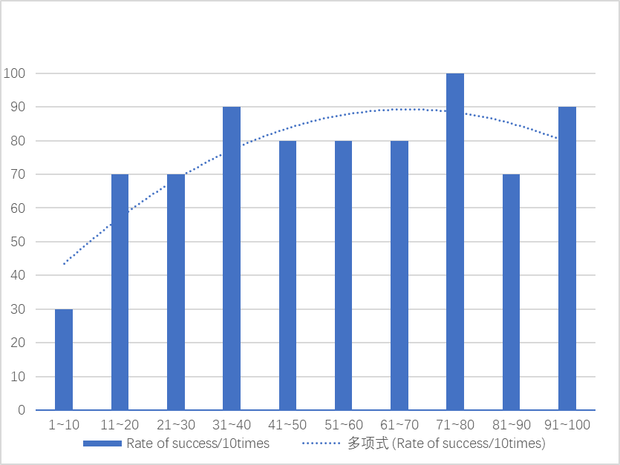


Experiment
77%
CLIENT INFORMATION At vero eos et accusam et justo duo dolores
CLIENT CHALLENGES At vero eos et accusam et justo duo dolores
SOLUTION Stet clita kasd gubergren,
The total success rate
The horizontal axis is the times of tests,
and the vertical axis is the success rate
Notes:
Duplicate header image

Slide 10

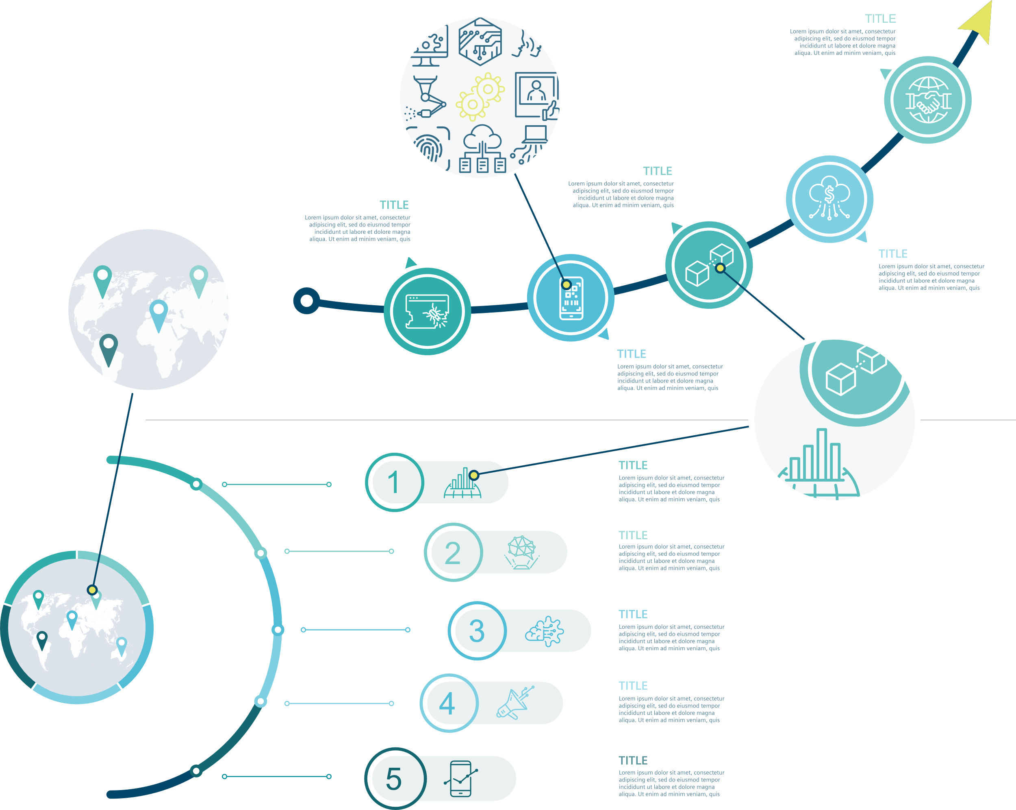
Expectation
Intellectualization
After a short period of training, the probability of the chess (agent) successfully reaching the end point increased significantly. Therefore, it is reasonable to believe that this model can be used as a rough methodology to guide the application of reinforcement learning in manufacturing in the future
Popularization
Manufacturing industry

Slide 11
That’s all .
Thank you for your listening.

